Slide 1
KS1 gymnastics
STRETCHING
I like to do static stretches during the warm up (rather than dynamic) because it is relevant
to what will happen in the lesson. – you should insist on control, good body tension and clear
body shapes.

Slide 2
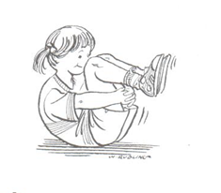
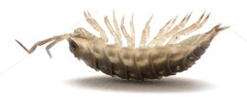
The Pea Bug

Slide 3
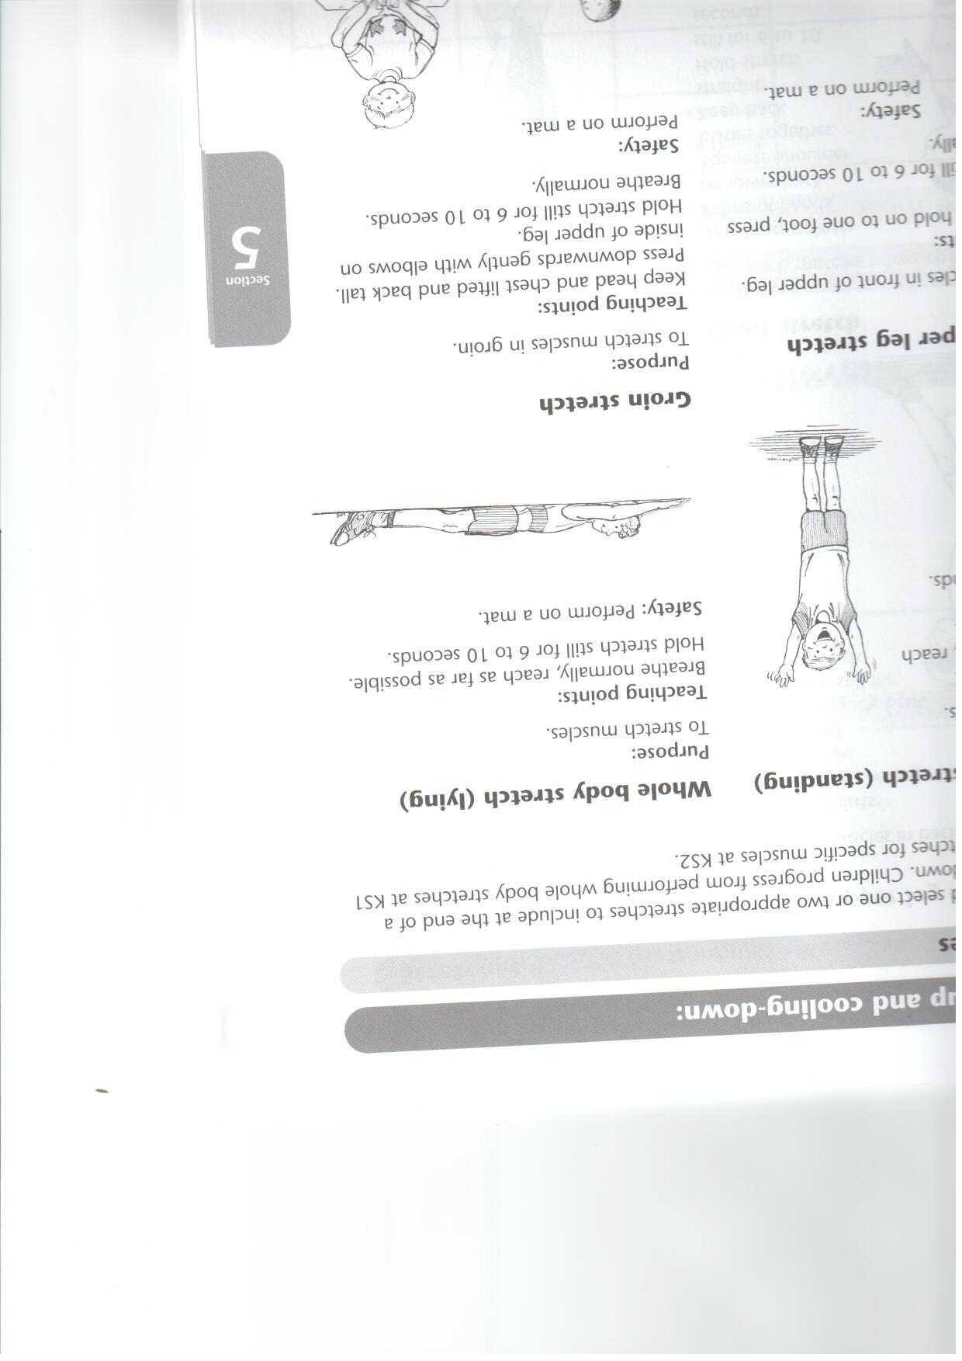
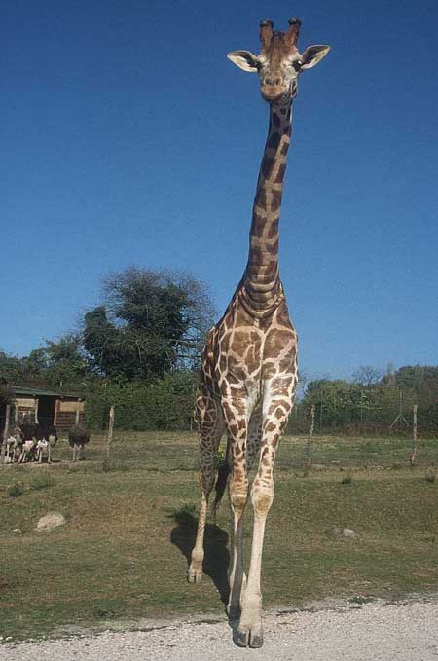
The Giraffe

Slide 4
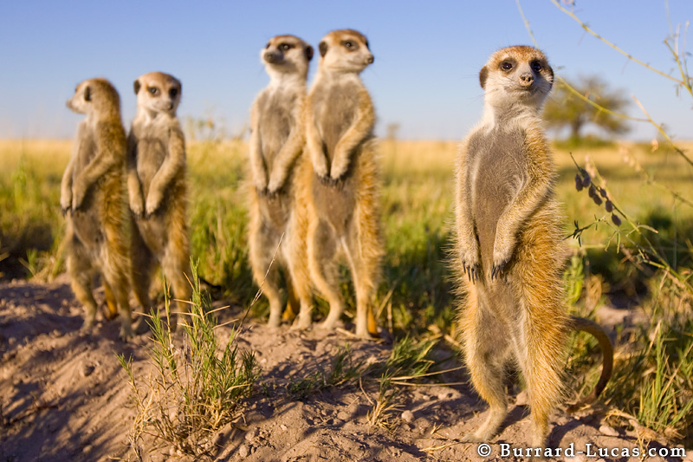
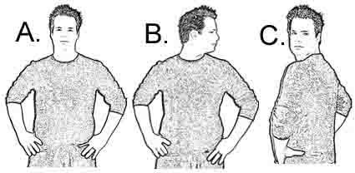
The Meerkat

Slide 5
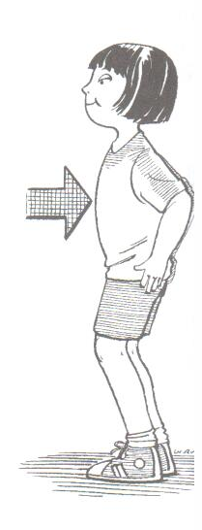
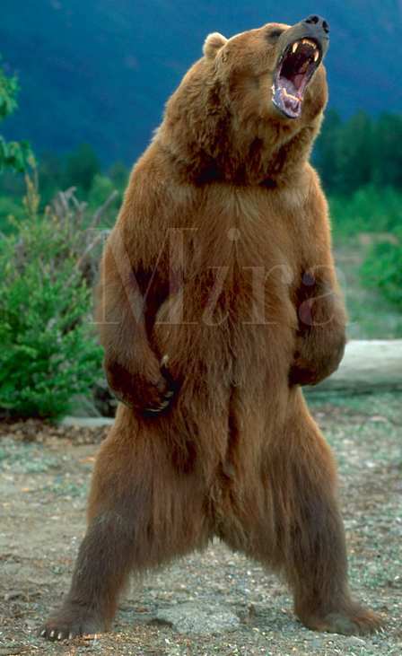
The Angry Bear

Slide 6
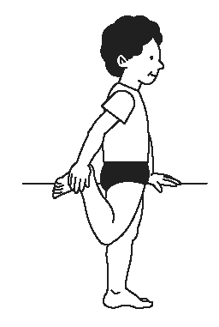
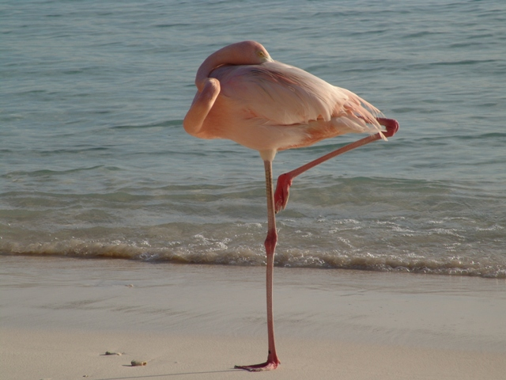
The Flamingo

Slide 7
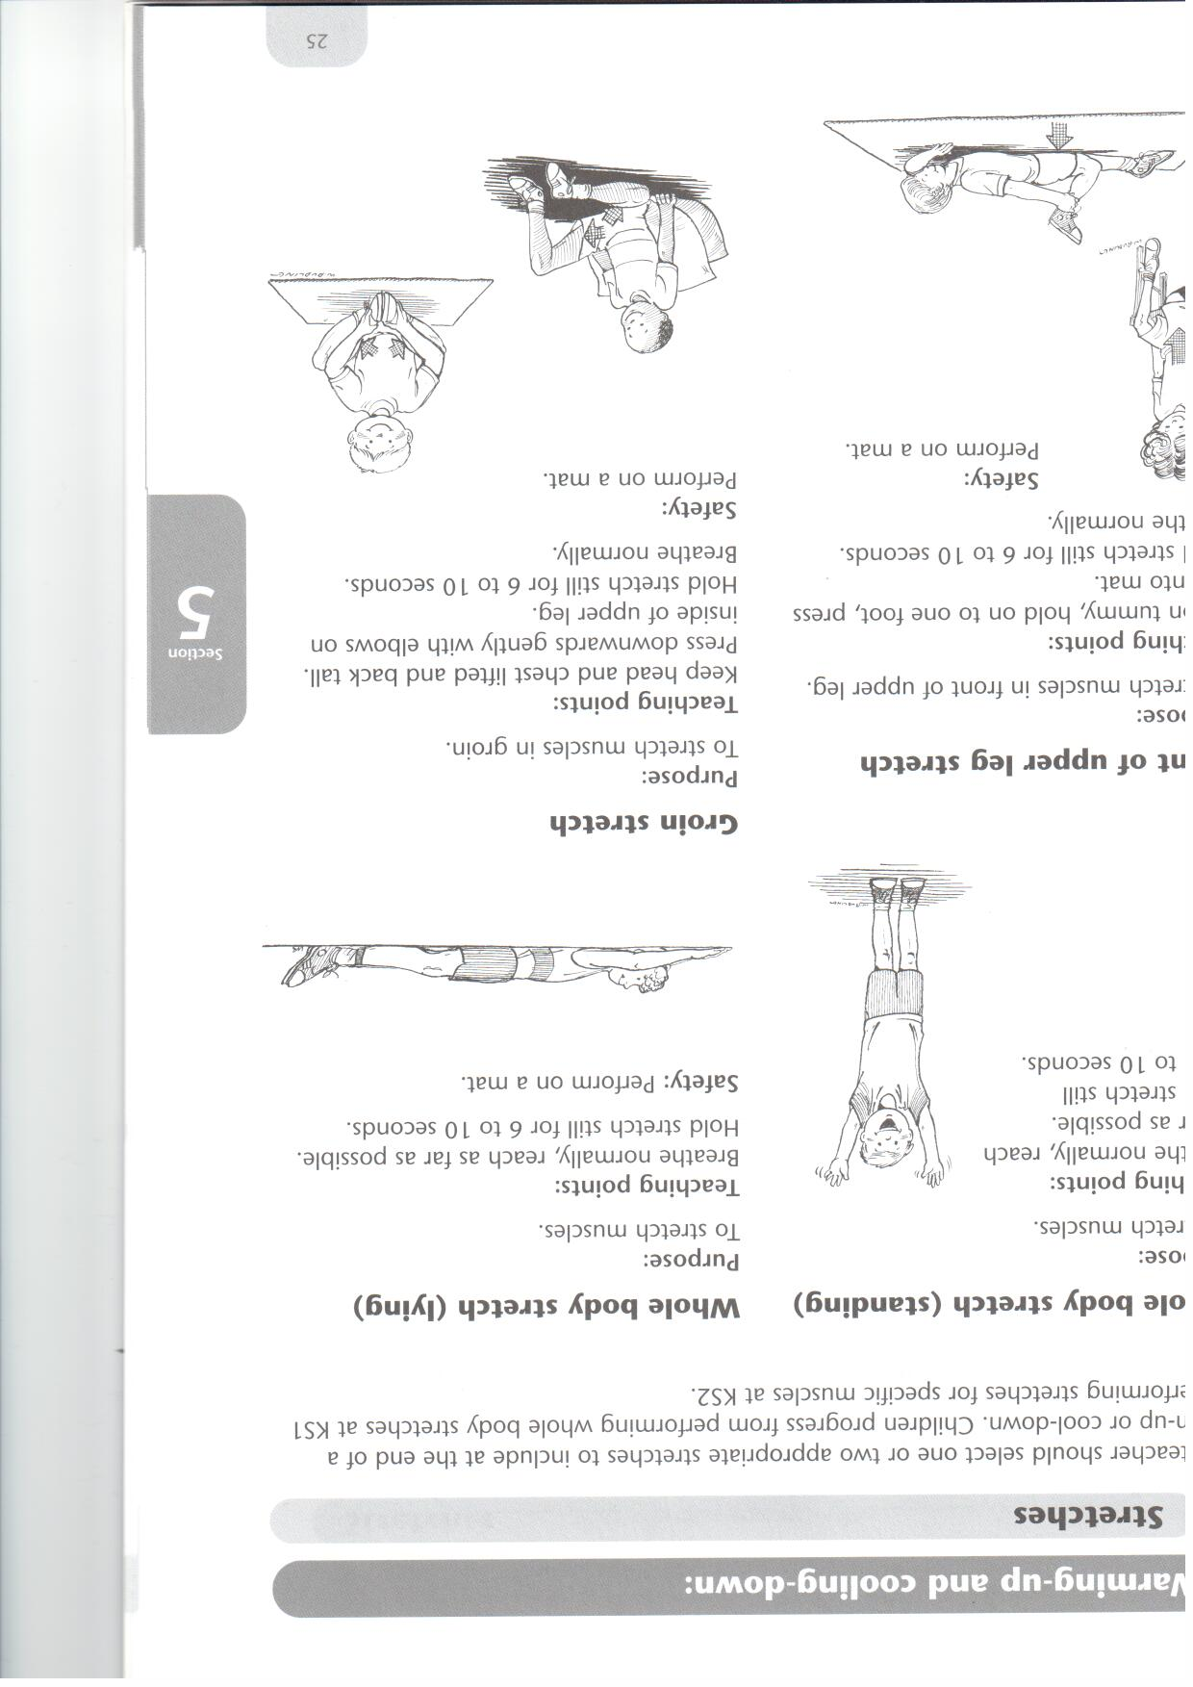
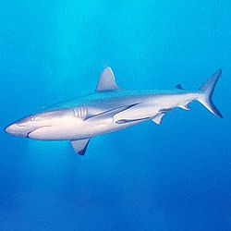
The Shark

Slide 8
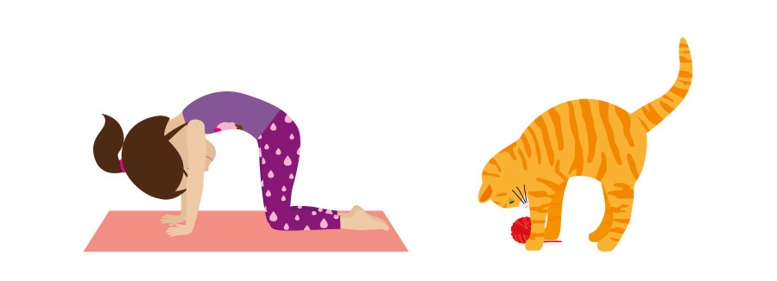
The cat

Slide 9
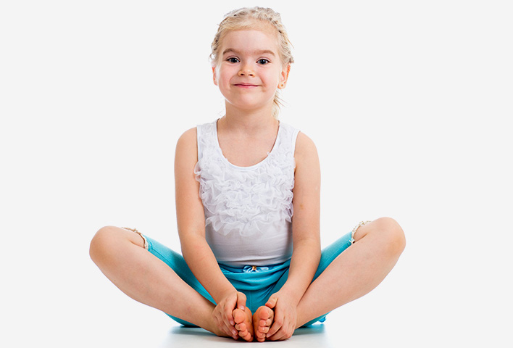

The butterfly

Slide 10
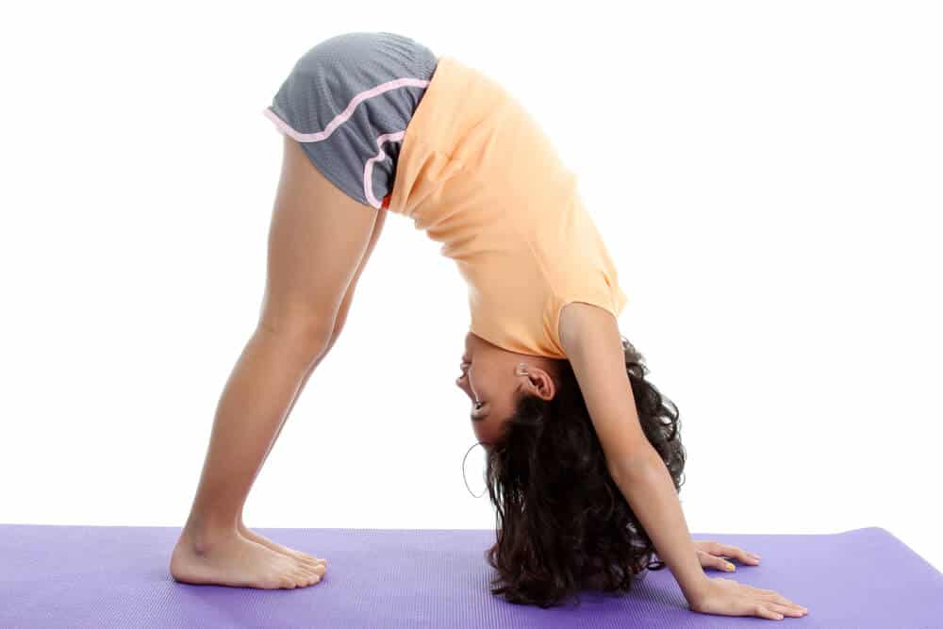
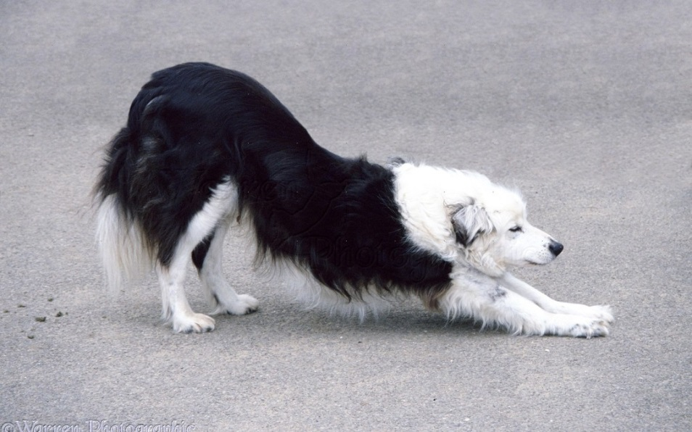
The dog

Slide 11
The next slide is very important. Many children have difficulty sitting at a table
for any length of time because they have very poor core muscles.
If you do this after the warm up, it will help them to build up their core muscles
as well as increasing their vocabulary, learning how to build a routine and having fun.
I would do the first three positions in the first lesson and then add a few more
each lesson.
They can start off holding each position for 3 seconds and slowly build it up to 8 seconds.
You could take photos of the children who show good tension, clear shapes and the correct
positioning of body parts – then swap them with the ones that I have taken from the internet.

Slide 12
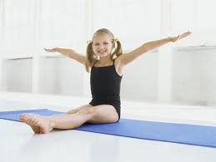
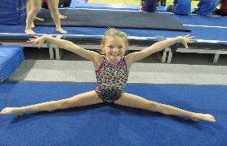
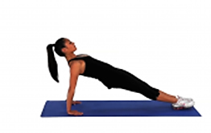
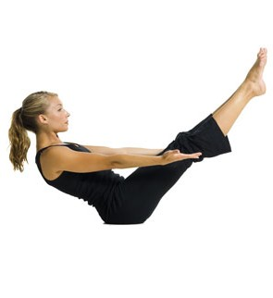
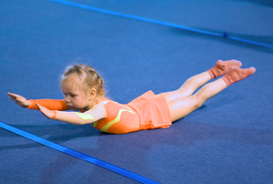
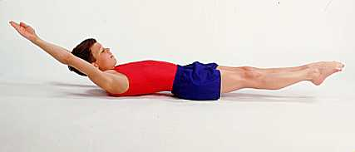
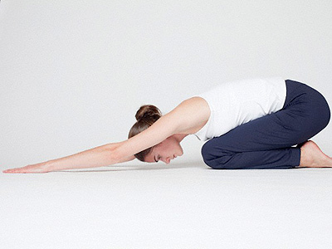
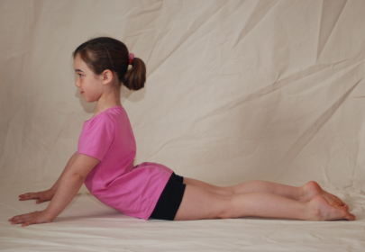
CORE STABILITY
What muscles are stabilizing the body?
What muscles are being strengthened?
Emphasize good form while holding positions.
LONG SIT
BACK SUPPORT
STRADDLE
ARCH
DISH
V SIT
CHILDS POSE
COBRA
Notes:
A core stability routine. Sequence building. Build into each lesson. Use as cool down. Learning technical terminology.

